Slide 1

BIA-670

Slide 2
(Minimal)
(Practical)
Introduction to C++ and OOP

Slide 3
Getting started
// my first program in C++
#include <iostream>
int main ()
{
std::cout << "Hello World!";
return 0;
}
// This is a comment line
#include <iostream>
  directive for the preprocessor
cout << "Hello World";
  C++ statement
  cout is declared in the iostream standard file within the std namespace
  cin
  semicolon (;) marks the end of the statement
return 0;
  the return statement causes the main function to finish
  return may be followed by a return code (here: 0)
    return code 0 for the main function is generally interpreted as the program worked OK
int main ()
  beginning of the definition of the main function
  the main function is the point by where all C++ programs start their execution
  all C++ programs must have a main function
  body enclosed in braces {}

Slide 4
Compilation
make myFirstProgram
Preprocessor
Inlines #includes etc.
Compiler
Translates into machine code
Associates calls with functions
Object files
Executable
Linker
Associates functions with definitions
myFirstProgram
External Libraries, libc.so, libcs123.so

Slide 5
Using namespace
#include <iostream>
#include <string>
...
std::string question = “What do I learn this week?”;
std::cout << question << std::endl;
using namespace std;
…
string answer = “How to use Geant4”;
cout << answer << endl;
Notes:
Does this go here???

Slide 6
Variables
#include <iostream>
#include <string>
using namespace std;
int main ()
{
// declaring variables:
int a, b; // declaration
int result;
// process:
a = 5;
b = 2;
a = a + 1;
result = a - b;
// print out the result:
cout << result << endl;
string myString = "This is a string";
cout << myString << endl;
const int neverChangeMe = 100;
// terminate the program:
return 0;
}
Scope of variables
  global variables can be referred from anywhere in the code
  local variables: limited to the block enclosed in braces ({})
Initialization
int a = 0; // assignment operator
int a(0); // constructor
const
the value cannot be modified after definition

Slide 7
References and Pointers
The address that locates a variable within memory is what we call a reference to that variable
x = &y; // reference operator & “the address of”
int i = 10;
int& ir = i; // reference (alias)
ir = ir + 1; // increment i
Reference
is an alias
A variable which stores a reference to another variable is called a pointer
Pointers are said to "point to" the variable whose reference they store
z = *x; // z equal to “value pointed by” x
double* z; // z is a pointer to a double
double x = 35.7;
z = &x; // therefore *z is 35.7
z = 0; // null pointer (not pointing to any valid reference or memory address)

Slide 8
Read pointer declarations right to left
// A const River
const River nile;
// A pointer to a const River
const River* nilePc;
// A const pointer to a River
River* const nileCp;
// A const pointer to a const River
const River* const nileCpc;

Slide 9
Dynamic memory
Operator new
pointer = new type
Student* paul = new Student;
If the allocation of this block of memory failed,
the failure could be detected by checking if paul took a null pointer value:
if (paul == 0) {
// error assigning memory, take measures
};
Operator delete
delete paul;
Dynamic memory should be freed once it is no longer needed,
so that the memory becomes available again for other requests of dynamic memory
Rule of thumb: every new must be paired by a delete
Failure to free memory: memory leak

Slide 10
C++ Gotcha
Do not return pointers (or references) to local variables!
double* myFunction(void) {
double d;
return &d;
}
int main() {
double* pd = myFunction();
*pd = 3.14;
return 0;
}
Boom! (maybe)
Notes:
Why is this a problem?
And more importantly, why is the crash not deterministic?

Slide 11
C++ “Gotcha”
Uninitialized pointers are bad!
  int* i;
  if ( someCondition ) {
  …
  i = new int;
  } else if ( anotherCondition ) {
  …
  i = new int;
  }
  *i = someVariable;
“null pointer exception”
Notes:
Fortunately for Java programmers, references are automatically initialized to “null”. You don’t get that in C++. You don’t get that determinism from C++ pointers – this is a similar problem to previous “gotcha”; you simply don’t know what’s going to be in that memory location

Slide 12

Memory allocation jargon
“on the stack”
  scope: block delimited by {}
  object alive till it falls out of scope
  calls constructor / destructor
“on the heap”
  new and delete operators
  new calls constructor, delete calls destructor
  object exists independently of scope in which it was created
  also “on the free store” or “allocated in dynamic memory”
  be careful: new → delete, new[] → delete[]
  for safety, same object should both allocate and deallocate

Slide 13
Operators
(most common ones)
Assignment =
Arithmetic operators +, -, *, /, %
Compound assignment +=, -=, *=, /=, …
a+=5; // a=a+5;
Increase and decrease ++, --
a++; // a=a+1;
Relational and equality operators ==, !=, >, <, >=, <=
Logical operators ! (not), && (and), || (or)
Conditional operator ( ? )
a>b ? a : b
// returns whichever is greater, a or b
Explicit type casting operator
int i; float f = 3.14; i = (int) f;

Slide 14
Control structures
if (x == 100)
{
cout << "x is ";
cout << x;
}
if (x == 100)
cout << "x is 100";
else
cout << "x is not 100";
do {
cout << "Enter number (0 to end): ";
cin >> n;
cout << "You entered: " << n << endl;
} while (n != 0);
while (n>0) {
cout << n << ", ";
--n;
}
for (initialization; condition; increase) statement;
for (int n=10; n>0; n--) {
cout << n << ", ";
}
for (n=10; n>0; n--)
{
cout << n << ", ";
if (n==3)
{
cout << "countdown aborted!";
break;
}
}
loop:
cout << n << ", ";
n--;
if (n>0) goto loop;
cout << “Procedural programming!“ ;
Notes:
for (int n=10; n>0; n--) { cout << n << ", "; }

Slide 15
Functions
In C++ all function parameters are passed by copy
Type name(parameter1, parameter2, ...)
{
statements…;
return somethingOfType;
}
No type: void
void printMe(double x)
{
std::cout << x << std::endl;
}
Arguments passed by value and by reference
int myFunction (int first, int second);
Pass a copy of parameters
int myFunction (int& first, int& second);
Pass a reference to parameters
They may be modified in the function!
int myFunction (const int& first, const int& second);
Pass a const reference to parameters
They may not be modified in the function!

Slide 16
More on Functions
Default values in parameters
double divide (double a, double b=2. )
{
double r;
r = a / b;
return r;
}
int main ()
{
cout << divide (12.) << endl;
return 0;
}
Overloaded functions
Same name, different parameter type
A function cannot be overloaded only by its return type
int operate (int a, int b)
{
return (a*b);
}
double operate (double a, double b)
{
return (a/b);
}

Slide 17
OOP basics

Slide 18
OOP basic concepts
Object, Class
  A class defines the abstract characteristics of a thing (object), including the thing's attributes and the thing's behaviour
Inheritance
  “Subclasses” are more specialized versions of a class, which inherit attributes and behaviours from their parent classes (and can introduce their own)
Encapsulation
  Each object exposes to any class a certain interface (i.e. those members accessible to that class)
  Members can be public, protected or private
Abstraction
  Simplifying complex reality by modelling classes appropriate to the problem
  One works at the most appropriate level of inheritance for a given aspect of the problem
Polymorphism
  It allows one to treat derived class members just like their parent class' members

Slide 19
Class and Object
Object: is characterized by
attributes (which define its state) and operations
A class is the blueprint of objects of the same type
class Rectangle {
public:
Rectangle (double,double); // constructor
~Rectangle() { // empty; } // destructor
double area () { return (width * height); } // member function
private:
double width, height; // data members
};
Rectangle rectangleA (3.,4.); // instantiate an object of type “Rectangle”
Rectangle* rectangleB = new Rectangle(5.,6.);
cout << “A area: " << rectangleA.area() << endl;
cout << “B area: " << rectangleB->area() << endl;
delete rectangleB; // invokes the destructor

Slide 20
The class interface in C++
Usually defined in a header (.h or .hh) file:
class Car {
public:
// Members can be accessed by any object
protected:
// Can only be accessed by Car and its derived objects
private:
// Can only be accessed by Car for its own use.
};

Slide 21
Constructor and assignment
class String {
public:
String( const char* value ); // constructor
String( const String& rhs ); // copy constructor
~String();
String& operator=( const String& rhs); // assignment operator
private:
char* data;
};
int main() {
String s1 = “anton”;
String s2( “luciano” );
s2 = s1;
};
Notes:
What happens in the main program, if:
a copy constructor is defined (write it);
a destructor is defined (write it);
an operator= is defined; (write it; check for a = a; return a reference to *this )
Note: in constructors, list initialization is ALWAYS performed in the order of declaration by the compiler...

Slide 22
Classes: Basic Design Rules
Hide all member variables
Hide implementation functions and data
Minimize the number of public member functions
Avoid default constructors
Use const whenever possible / needed
  A invokes a function of a B object
  A creates an object of type B
  A has a data member of type B
OK:
Bad:
  A uses data directly from B
  (without using B’s interface)
Even worse:
  A directly manipulates data in B
Notes:
default constructor can be overcome by default parameters.
Issue: default parameters and overloading can result in ambiguities: use overloading if the same action can be performed with different algorithms, use default values if a default value makes sense.
Complete and minimal classes...
default functions are written by the compiler if no one is declared for: default constructor (if no constructor at all is declared); destructor; operator =
Constness: it is part of the design ! it is possibke to bypass non-const implementations of const functions by using the keyword ‘mutable’ (or const_cast if mutable is not supported).

Slide 23
Inheritance
A key feature of C++
Inheritance allows to create classes derived from other classes
Public inheritance defines an “is-a” relationship
  In other words: what applies to a base class applies to its derived classes
class Base {
public:
virtual ~Base() {}
virtual void f() {…}
protected:
int a;
private:
int b; …
};
class Derived : public Base {
public:
virtual ~Derived() {}
virtual void f() {…}
…
};

Slide 24
Polymorphism
Mechanism that allows a derived class to modify the behaviour of a member declared in a base class
  Base* b = new Derived;
  b->f();
  delete b;
Which f() gets called?

Slide 25

Liskov Substitution Principle
One way of expressing the notion of subtype (or “is-a”)
  If Derived is a subtype of Base, then
  Base can be replaced everywhere with Derived,
  without impacting any of the desired properties of the program
In other words, you can substitute Base with Derived, and nothing will “go wrong”

Slide 26
Inheritance and virtual functions
class Shape
{
public:
Shape();
virtual void draw();
};
A virtual function defines the interface and provides an implementation; derived classes may provide alternative implementations
class Circle : public Shape
{
public:
Circle (double r);
void draw();
private:
double radius;
};
class Rectangle : public Shape
{
public:
Rectangle(double h, double w);
private:
double height, width;
};

Slide 27
Abstract classes, Abstract interfaces
Abstract class, cannot be instantiated
Abstract Interface
a class consisting of
pure virtual functions only
class Shape
{
public:
Shape();
virtual area() = 0;
};
A pure virtual function
defines the interface
and delegates the implementation
to derived classes
class Circle : public Shape
{
public:
Circle (double r);
double area();
private:
double radius;
};
class Rectangle : public Shape
{
public:
Rectangle(double h, double w);
double area();
private:
double height, width;
};
Concrete class

Slide 28
Inheritance and Virtual Functions
 | Inheritance of the interface | Inheritance of the implementation
Non virtual function | Mandatory | Mandatory
Virtual function | Mandatory | By default Possible to reimplement
Pure virtual function | Mandatory | Implementation is mandatory

Slide 29
More C++

Slide 30
Templates
Minimal introduction, only to introduce STL
A C++ template is just that, a template
A single template serves as a pattern, so it can be used multiple times to create multiple instantiations
template <typename T>
void f(T i) {… }
One function in source code
Compilation & instantiation
f:
save_regs
ld r0, sp(0)
add 4
ret
f:
save_regs
ld r0, sp(4)
add 8
ret
f:
save_regs
ld r0, sp(8)
add 16
ret
Function templates
Class templates
Member templates
Multiple functions in assembly language

Slide 31
Compilation
Instantiation
f<char>:
save_regs
ld r0, sp(0)
add 4
ret
void
f(char i)
{…}
template
<typename T>
void
f(T i)
{…}
f<int>:
save_regs
ld r0, sp(4)
add 8
ret
void
f(int i)
{…}
f<double>:
save_regs
ld r0, sp(8)
add 16
ret
void
f(double i)
{…}
Multiple functions in assembly language

Slide 32
Standard Template Library (STL)
Containers
Sequence
  vector: array in contiguous memory
  list: doubly-linked list (fast insert/delete)
  deque: double-ended queue
  stack, queue, priority queue
Associative
  map: collection of (key,value) pairs
  set: map with values ignored
  multimap, multiset (duplicate keys)
Other
  string, basic_string
  valarray:for numeric computation
  bitset: set of N bits
Algorithms
Non-modifying
  find, search, mismatch, count, for_each
Modifying
  copy, transform/apply, replace, remove
Others
  unique, reverse, random_shuffle
  sort, merge, partition
  set_union, set_intersection, set_difference
  min, max, min_element, max_element
  next_permutation, prev_permutation

Slide 33
std::string
Example:
#include <string>
void FunctionExample()
{
std::string s, t;
char c = 'a';
s.push_back(c); // s is now “a”;
const char* cc = s.c_str(); // get ptr to “a”
const char dd[] = ‘like’;
t = dd; // t is now “like”;
t = s + t; // append “like” to “a”
}

Slide 34
std::vector
use std::vector,
not built-in C-style array, whenever possible
Example:
#include <vector>
void FunctionExample()
{
std::vector<int> v(10);
int a0 = v[3]; // unchecked access
int a1 = v.at(3); // checked access
v.push_back(2); // append element to end
v.pop_back(); // remove last element
size_t howbig = v.size(); // get # of elements
v.insert(v.begin()+5, 2); // insert 2 after 5th element
}

Slide 35
std::vector (more)
Example:
#include <vector>
#include <algorithm>
void FunctionExample()
{
std::vector<int> v(10);
v[5] = 3; // set fifth element to 3
std::vector<int>::const_iterator it
= std::find(v.begin(), v.end(), 3);
bool found = it != v.end();
if (found) {
int three = *it;
}
}

Slide 36
Iterators
iterator – kind of generalized pointer
Each container has its own type of iterator
void FunctionExample() {
stl::vector<int> v;
stl::vector<int>::const_iterator it = v.begin();
for (it = v.begin() ; it != v.end() ; it++) {
int val = *it;
}
}

Slide 37
A few practical issues

Slide 38
Organizational Strategy
image.hh
Header file: Class definition
void SetAllPixels(const Vec3& color);
image.cc
.cc file: Full implementation
void Image::SetAllPixels(const Vec3& color) {
for (int i = 0; i < width*height; i++)
data[i] = color;
}
main.cc
Main function
myImage.SetAllPixels(clearColor);

Slide 39
How a Header File looks like
Segment.h
header file
begin header guard
#ifndef SEGMENT_HEADER
#define SEGMENT_HEADER
class Point;
class Segment
{
public:
Segment();
virtual ~Segment();
double length();
private:
Point* p0,
Point* p1;
}
#endif // SEGMENT_HEADER
forward declaration
class declaration
constructor
destructor
member functions
member variables
need semi-colon
end header guard

Slide 40
Forward Declaration
Gui.hh
In header files, only include what you must
If only pointers to a class are used, use forward declarations
Class Gui
{
//
};
Controller.hh
//Forward declaration
class Gui;
class Controller
{
//...
private:
Gui* myGui;
//...
};
Notes:
Minimize compile dependency.
Speeds up compilation. (don’t need to recompile every time gui.H changes)

Slide 41
Header file and implementation
File Segment.hh
File Segment.cc
#ifndef SEGMENT_HEADER
#define SEGMENT_HEADER
class Point;
class Segment
{
public:
Segment();
virtual ~Segment();
double length();
private:
Point* p0,
Point* p1;
};
#endif // SEGMENT_HEADER
#include “Segment.hh”
#include “Point.hh”
Segment::Segment() // constructor
{
p0 = new Point(0.,0.);
p1 = new Point(1.,1.);
}
Segment::~Segment() // destructor
{
delete p0;
delete p1;
}
double Segment::length()
{
function implementation …
}
Notes:
Declarations go in .H file
Definitions go in .C file
Good because:
can see interface without implementations
lets others use your functions etc.

Slide 42
“Segmentation fault (core dumped)”
Typical causes:
int intArray[10];
intArray[10] = 6837;
Image* image;
image->SetAllPixels(colour);
Access outside of
array bounds
Attempt to access
a NULL or previously
deleted pointer
These errors are often very difficult to catch and can cause erratic, unpredictable behaviour

Slide 43
UML

Slide 44
Unified Modelling Language
The UML is a graphical language for
  specifying
  visualizing
  constructing
  documenting
the artifacts of software systems
Define an easy-to-learn, but semantically rich visual modeling language
Added to the list of OMG adopted technologies in November 1997 as UML 1.1
Version evolution

Slide 45
Building Blocks
The basic building blocks of UML are:
  model elements
    classes, interfaces, components, use cases etc.
  relationships
    associations, generalization, dependencies etc.
  diagrams
    class diagrams, use case diagrams, interaction diagrams etc.
Simple building blocks are used to create large, complex structures

Slide 46
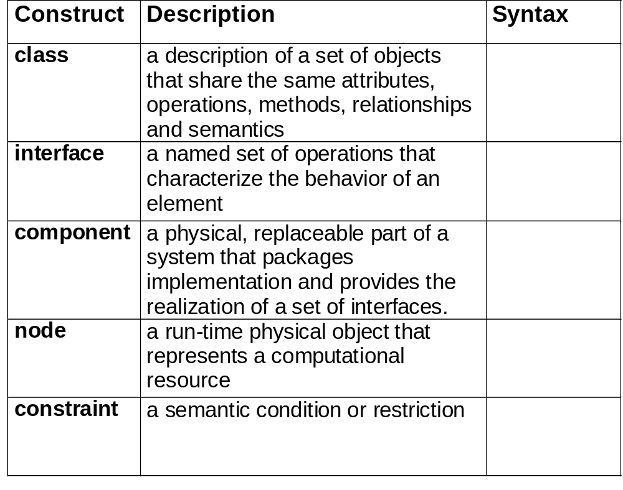
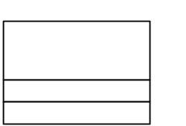

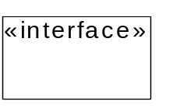
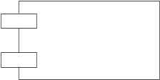
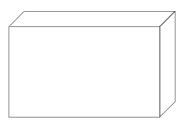
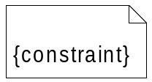
Structural Modeling: Core Elements

Slide 47
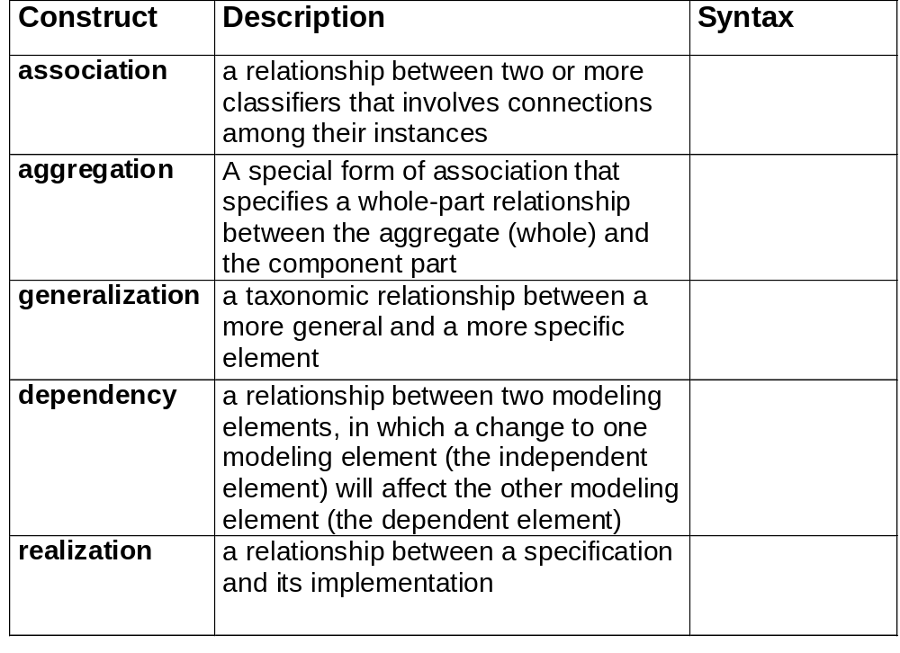





Structural Modeling: Core Relationships

Slide 48
Class
MyClassName
Classes can have 4 parts
  Name
  Attributes
  Operations
  Responsibilities
Classes can show visibility and types
+SomePublicAttribute : SomeType
-SomePrivateAttribute : SomeType
#SomeProtectedAttribute : SomeType
+ClassMethodOne()
+ClassMethodTwo()
Responsibilities
-- can optionally be described here.
All parts but the Name are optional
Notes:
An individual class is shown on the diagram as a box with up to four sections.
The first section shows the name of the class. Names should be nouns. Typically the first letter of every word in a name is capitalized.
Attributes represent the state of the object or what the object knows.
Operators represent the behavior of an object or what the object does.
Responsibilities are optional. A Responsibility is a contract or an obligation of the class. They are normally only used in analysis and early in the design phase to describe what a class should do without describing how it should do it.
The + sign indicates that an attribute or operation is public or visible to all other objects or operations in the system.
The - sign indicates that an attribute or operation is private or hidden from any objects or operations other than those objects also of the current class.
The # sign indicates that an attribute or operation is protected or visible only to members of the same class or members that are specialization's of (or derived from) that class.
The Parts of a Class

Slide 49
Generalization
Shape
Polygon
Ellipse
Circle
. . .
Models inheritance

Slide 50
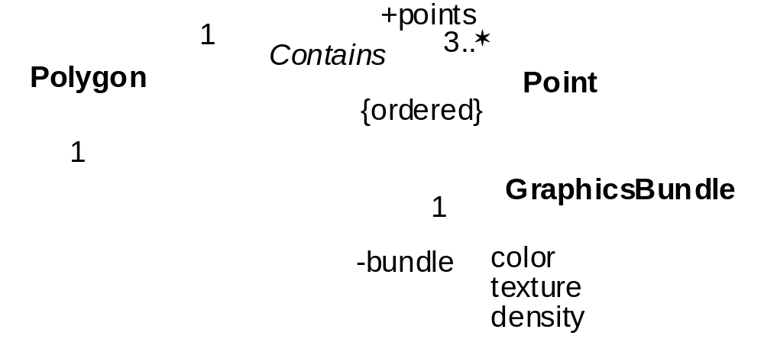
Associations

Slide 51
Aggregation or Composition?
Car
4
Wheel
Person
Brain
Aggregation is a relationship in which one object is a part of another
A aggregates B
=
B is part of A, but their lifetimes may be different
Composition is a relationship in which one object is an integral part of another
A contains B
=
B is part of A, and their lifetimes are the same

Slide 52
Main UML Diagrams
Class Diagrams
Use Case Diagrams
Collaboration Diagrams
Sequence Diagrams
Package Diagrams
Component Diagrams
Deployment Diagrams
Activity Diagrams
State Diagrams
Notes:
These are the diagrams covered during this course.
This information will be provided for each diagram:
Brief explanations
Where the diagram is used in ProVision
Diagram symbols
Each diagram with the symbols
Specific elements used for each diagram, such as supporting text
Types of UML Diagrams

Slide 53
UML Class Diagram
Describe the classes in the system
and the static relationships between classes
Multiplicity
Customer
1
Class
Aggregation
Abstract
Class
Rental Invoice
Rental Item
{abstract}
1..*
1
0..1
Composition
Association
Generalization
Checkout Screen
DVD Movie
CD Music
Video Game
Notes:
This class diagram shows examples of associations, aggregations, and generalizations. All of these topics are discussed in greater detail on later slides.
In general, associations describe the relationships between classes or objects. They start as simple connectors, to show that some relationship exists. As design progress (and often during development), the natures of the relationships become clearer, and the associations are modified to reflect the new knowledge. For example, direction (not shown above, but discussed later) and cardinality are usually added later in design. The diagram above shows that each Rental Contract is associated with exactly one Checkout Screen, whereas a Checkout Screen may be associated with zero or one Rental Contracts. Likewise, a business rule states that a customer may rent no more than six items per visit, so that cardinality is shown.
The diagram above shows a generalization relationship between several kinds of objects. Generalization means essentially the same thing in a class diagram that it does in a use case diagram. Here, the specializations (DVD Movie, VHS Movie, and N64 Game) of Rentable Item are fully consistent with Rentable Item and may be used wherever Rentable Item is allowed. Notice also that Rentable Item is {abstract}. This means that objects cannot be created from it, because one or more of its methods is not implemented. Abstract objects must be specialized. It is not necessary for a general object to be abstract; this is done (most commonly) when the general object serves to define an interface, and the specializations provide the meaningful implementation. Here, Rentable Item may not know how to calculate the rental fee -- each specialization is required to do that.
What is a Class Diagram?

Slide 54
Collaboration Diagram - Rent Movie
Describe object interactions organized around the objects and their links to each other
:Rented Items
5: add(customer, movies)
1: enter_customer()
8: generateRentalTotal()
3: enter_movies()
7: print invoice()
2: IsValidCustomer(CustId)
Object
:Check-out Manager
:Customer
:Clerk
4:GetMovieByBarcode()
Actor
:Inventory
Message
Notes:
The objects in rectangles represent class roles. The links (lines or paths) represent association roles. The arrows between class roles indicate message flows exchanged between objects. The message flows are labeled with both the sequence number of the message and the message that is sent between the class roles. A message triggers an operation in the receiving object. The sequence numbers indicate the sequence of messages within the next higher level of nesting.
A Collaboration Diagram for the Movie Store

Slide 55
Sequence Diagram - Rent Movie
Describe interactions between objects arranged in time sequence
:CheckoutMgr
Cust:Customer
:Inventory
:RentedItems
:Employee
1: find customer()
2: search (string)
3: enter movie()
Object
4: search (string)
Message
Activation
5: rent (movie)
6: add(Cust, item)
Lifeline
7: printInvoice()
8: generateRentalTotal()
Sequence and collaboration diagrams can be cloned from each other
Notes:
Depicts how the classes within the system work together. The objects at the top represent class roles. The dashed lines that extend from each object represent lifelines. The thin rectangles on the lifelines represent activations. The horizontal arrows between lifelines indicate the messages exchanged between objects. The horizontal arrows are labeled with the message that is sent between the class roles. The message triggers an operation in the receiving object.
The objects defined inside the rectangle can be defined in one of the three ways:
The object name, the object name and its class, or just the class name (anonymous object)
A Sequence Diagram Example

Slide 56
Sequence Diagram
object symbol
name : Class
other
lifeline
stimulus
name (…)
activation
new (…)
: Class
delete
return
create

Slide 57
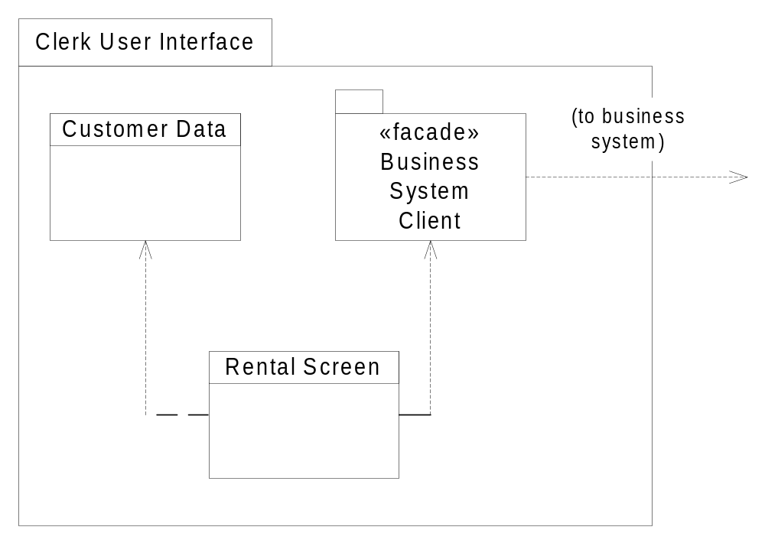
Package Diagram
Class
Package
Notes:
Packages are a grouping mechanism. A package can contain any other UML construction, including other packages. Packages are useful when producing diagrams that show a larger picture of the system.
A package “owns” its elements; no element can be owned by more than one package, but packages can refer to elements from other packages. Often, packages do not translate to executable elements. Some languages (Java, for example) support the concept of packages, but the UML does not require that the package correspond to an executable element.
Packages can have visibility: public, protected, private, and implementation visibilities are defined by the UML. Public means anyone can model elements within the package. Protected means only the package, or specializations of it, can see its model elements. Private means the package itself can use its elements, AND that another package that specifically imports an element can use that element. Implementation is similar to private, but disallows importing.
This package diagram is a fragment of the “Clerk’s User Interface”. The package contains a Customer Data class and a Business System façade package. It also contains a Rental Screen class, and shows that the Rental Screen class depends on the Customer Data class and the Business System façade.
What is a Package Diagram?

Slide 58
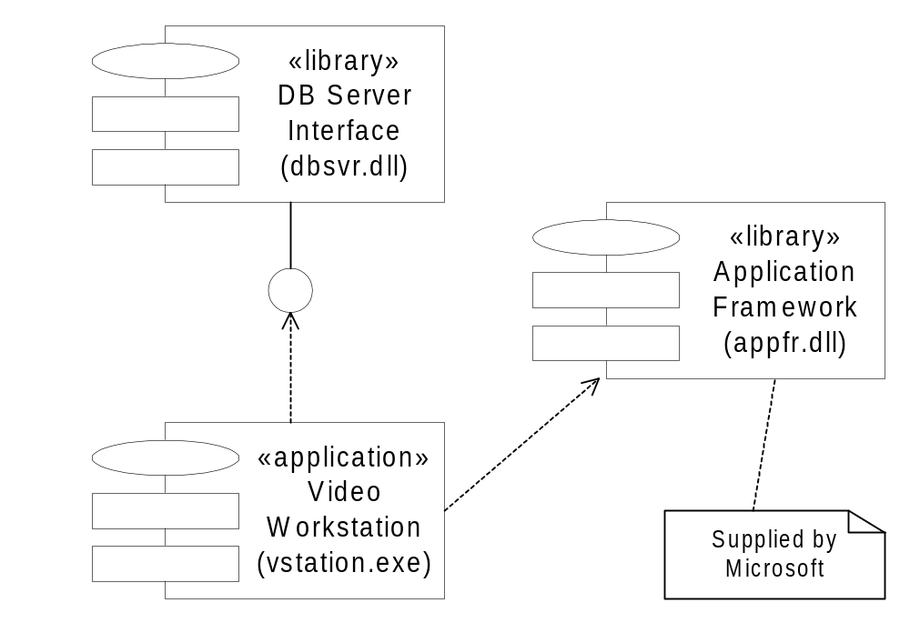
Component Diagram
Component
Interface
Dependency
Note
Notes:
A component diagram shows software components, and their dependencies. It is a way of describing the structure of the code. Components are physical entities; they represent the implementation of the logical architecture described by class diagrams, object diagrams, and interaction diagrams.
Components can be:
Source: some source code; a compilation unit. Meaningful at compile time. Stereotypes such as «file», «page», and «document» can provide additional information about the component’s nature.
Binary: object code, or a library file (static or dynamic). Meaningful at link or runtime (this will depend on the specific nature of the component). The stereotype «library» appears here.
Executable: executable code; an image. Meaningful at execution time. These at the only variety of component that can have instances (while they are running). The stereotypes «application» and «table» (a database table viewed as a runtime component) are common on this sort of component.
Components are types. To show instances of components, one draws a deployment diagram and allocates instances of executable components to the nodes where they run.
What is a Component Diagram?

Slide 59
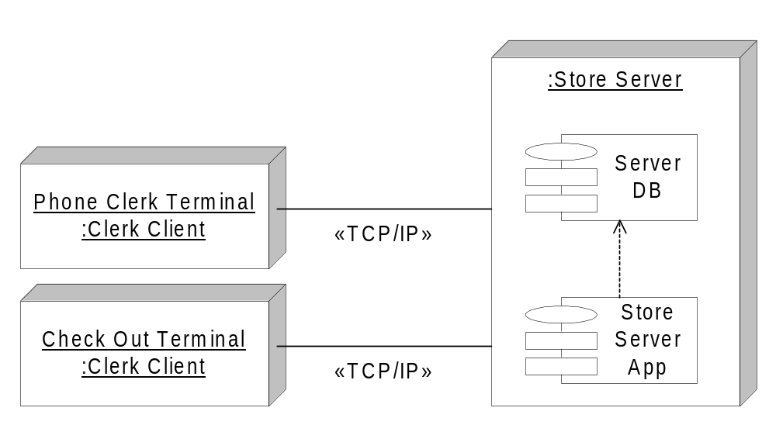
Deployment Diagram
Node
Communication
Association
Notes:
A deployment diagram shows the runtime architecture of the system and the topology (physical architecture) of the system. Each node represents a piece of hardware. A node is a special kind of class; the detailed capabilities of the node can be represented as attributes and/or properties of that class.
Nodes are connected by communication associations. These are typically directionless associations that are stereotyped (as in the diagram above) to show what kind of traffic they carry.
Components may be placed inside of nodes. This shows that the component runs on the node. A diagram which shows how nodes are connected may not have this level of detail, but a diagram that fully describes a node should. Packages containing components can also be used to simplify the diagram. Objects (instances of classes) can also be drawn in nodes, if appropriate. They can be drawn inside the component that implements them if desired, or they can be drawn standalone (the relationship between an object and the component that implements need not appear in a deployment diagram).
A component can be shown to depend on a node, with the stereotype «supports». This indicates that the node supports instances of the component (this is not shown in the diagram above).
Because nodes are classes, more complex relationships (including cardinality) are certainly possible. They can be associated in any way that is legal for classes (but some associations may not be useful).
What is a Deployment Diagram?

Slide 60
Introduction to Design Patterns

Slide 61
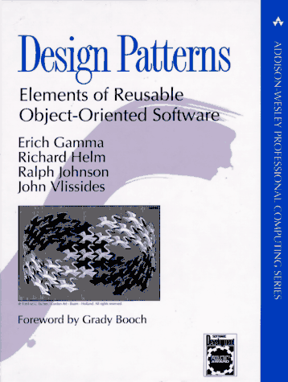

Design Patterns
Gamma, Helm, Johnson and Vlissides
Design Patterns,
Addison-Wesley 1995, ISBN 0-201-63361-2
(Gang-of-Four)
Each design pattern names, explains and evaluates an important and recurring design in object-oriented systems
A design pattern makes it easier to reuse successful designs and architectures
Three categories of patterns
  Creational
  Structural
  Behavioral
…also worthwhile reading!

Slide 62
List of design patterns
Abstract Factory
Adapter
Bridge
Builder
Chain of Responsibility
Command
Composite
Decorator
Facade
Factory Method
Flyweight
Interpreter
Iterator
Mediator
Memento
Observer
Prototype
Proxy
Singleton
State
Strategy
Template Method
Visitor

Slide 63

Abstract Factory
Provide an interface for creating families of related or dependent objects without specifying their concrete classes
AbstractFactory
  declares an interface for operations that create product objects
ConcreteFactory
  implements the operations to create concrete product objects

Slide 64
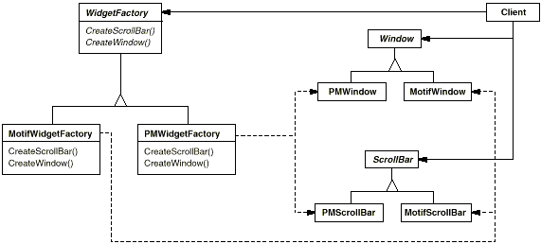
Abstract Factory example

Slide 65
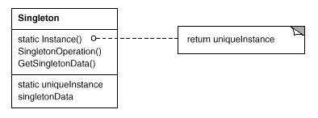
Singleton
Ensure a class only has one instance, and provide a global point of access to it
  Many times need only one instance of an object
    one file system
    one print spooler
    …
Singleton
  defines a class-scoped instance() operation that lets clients access its unique instance
  may be responsible for creating its own unique instance

Slide 66
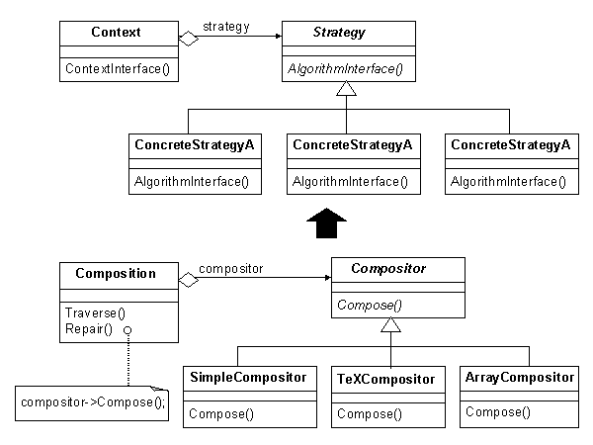
Strategy
Allow any one of a family of related algorithms to be easily substituted in a system
Define a family of algorithms, encapsulate each one, and make them interchangeable
Strategy lets the algorithm vary independently from clients that use it

Slide 67
Further reading

Slide 68
Books
+ Get a good mentor!
There are many good C++, OOP, UML, OOAD books on the market
  The following is just a personal selection
Introductory C++ book
S. B. Lippman, J. Lajoie, C++ primer, Addison-Wesley
Reference STL book
N. Josuttis, The C++ Standard Library, A Tutorial and Reference, Addison-Wesley
More advanced C++ books
S. Meyers, Effective C++, Addison-Wesley
S. Meyers, More effective C++, Addison-Wesley
S. Meyers, Effective STL, Addison-Wesley
UML books
M. Fowler, UML distilled, Addison-Wesley
G. Booch et al., The Unified Modeling Language, User Guide, Addison-Wesley
Basic OOAD books
G. Booch, OO analysis and design, Addison-Wesley
R. Martin, Designing OO C++ applications using the Booch method, Prentice Hall
Advanced design books
E. Gamma et al., Design Patterns, Addison-Wesley
John Lakos, Large-Scale C++ Software Design, Addison-Wesley
Hardcore design book
A. Alexandrescu, Modern C++ design, Addison-Wesley

Slide 69
Ricardo A. Collado
rcollado@stevens.edu
(201) 216-8156

